Slide 1
Social Life Networks:
Concept, Research Challenges and Progress
Professor Athula Ginige
School of Computing and Mathematics
University of Western Sydney
Australia

Slide 2
SLN4MOP
International Collaborative project to develop Social Life Networks for the Middle of the Pyramid.
Current collaborates are University of Western Sydney, Australian Catholic University, Macquarie University, University of California Irvine, University of Salerno in Italy, University of Colombo and University of Ruhuna.
First pilot project SLN for Sri Lankan farmers
http://www.sln4mop.org

Slide 3
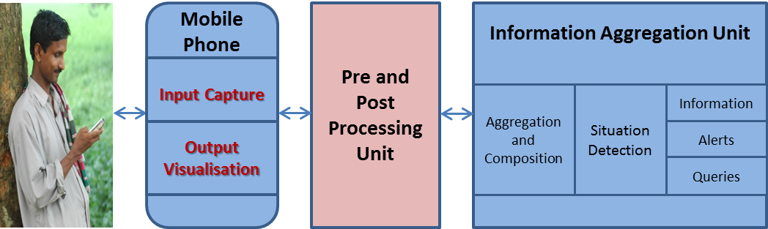
Initial System Architecture

Slide 4
Research Challenges - Overall System
What are the potential scenarios that can benefit from Social Life Networks
What factors will motivate people to use such a system
What impact such a system will have on Social Processes.

Slide 5
Research Challenges - Sub Systems
Input and output Subsystem.
  Language and Usability issues
  Data input method
  Output data visualisation
Processing Subsystem
  Data validity
  Managing application domain knowledge
  etc
Aggregation Subsystem
  What information alerts are required for different types of applications.
  Sequence of operations to generate information and alerts and respond to user queries

Slide 6

SLN4MOP Research Methodology
Exploring possibilities using Action Research
Requirements for Aggregation Unit
Requirements
Artefacts
Evaluations
Aggregation Unit
Requirements for Processing Unit
Processing Unit
Requirements for User Interface Unit
Mobile App
Stakeholder Needs
SLN for Farmers
Evaluation

Slide 7
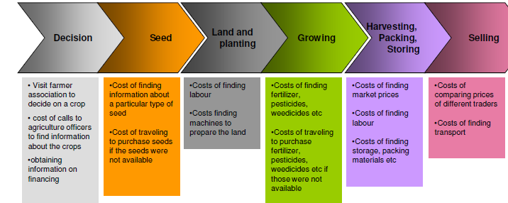
Farmer Information Need Analysis

Slide 8
Information Need - 1
What Crop to Grow?
What are the best seeds to be cultivated? (Quality)
From whom/where to buy good quality seeds at a lower rate? (Quality / Resource Prices)
How much yield is estimated for the selected vegetable seeds? (Prediction)
What would be the weather within the harvesting period? Any sudden changes that would affect the yield? (Quality / Precautions / Decision taking)
What are the best fertilizers to be used for the selected crops and in which quantities?(Quality)
From where to buy good fertilizer at a lower rate? (Quality / Resource Prices)
What are the precautions to be carried out to avoid specific pest and diseases? (Quality / Precautions / Decision taking)

Slide 9
Information Need - 2
In case of a disease what are steps to be carried out? (Quality / Knowledge)
Any disease that spreads within neighbouring farm yards? (Quality / Precautions / Decision taking)
How to inform other farmers with respect to the pest and diseases? (Agricultural Knowledge / Information Sharing)
What others grow? Cultivation extent? (Agricultural Knowledge / Precautions / Decision taking)
How to inform others that farmer would be growing a specific crop? (Agricultural Knowledge / Information Sharing)
What are the other possible ways of selling the harvest? Any other vendors? (Agricultural Knowledge )
How to inform other food processing companies that farmer have grown a specific crop? How to get aware of any special interests of such companies? (Agricultural Knowledge / Information Sharing / Decision making)

Slide 10
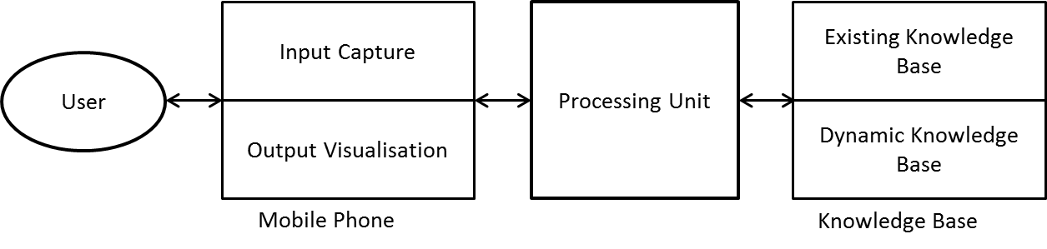
High Level Conceptual Architecture

Slide 11
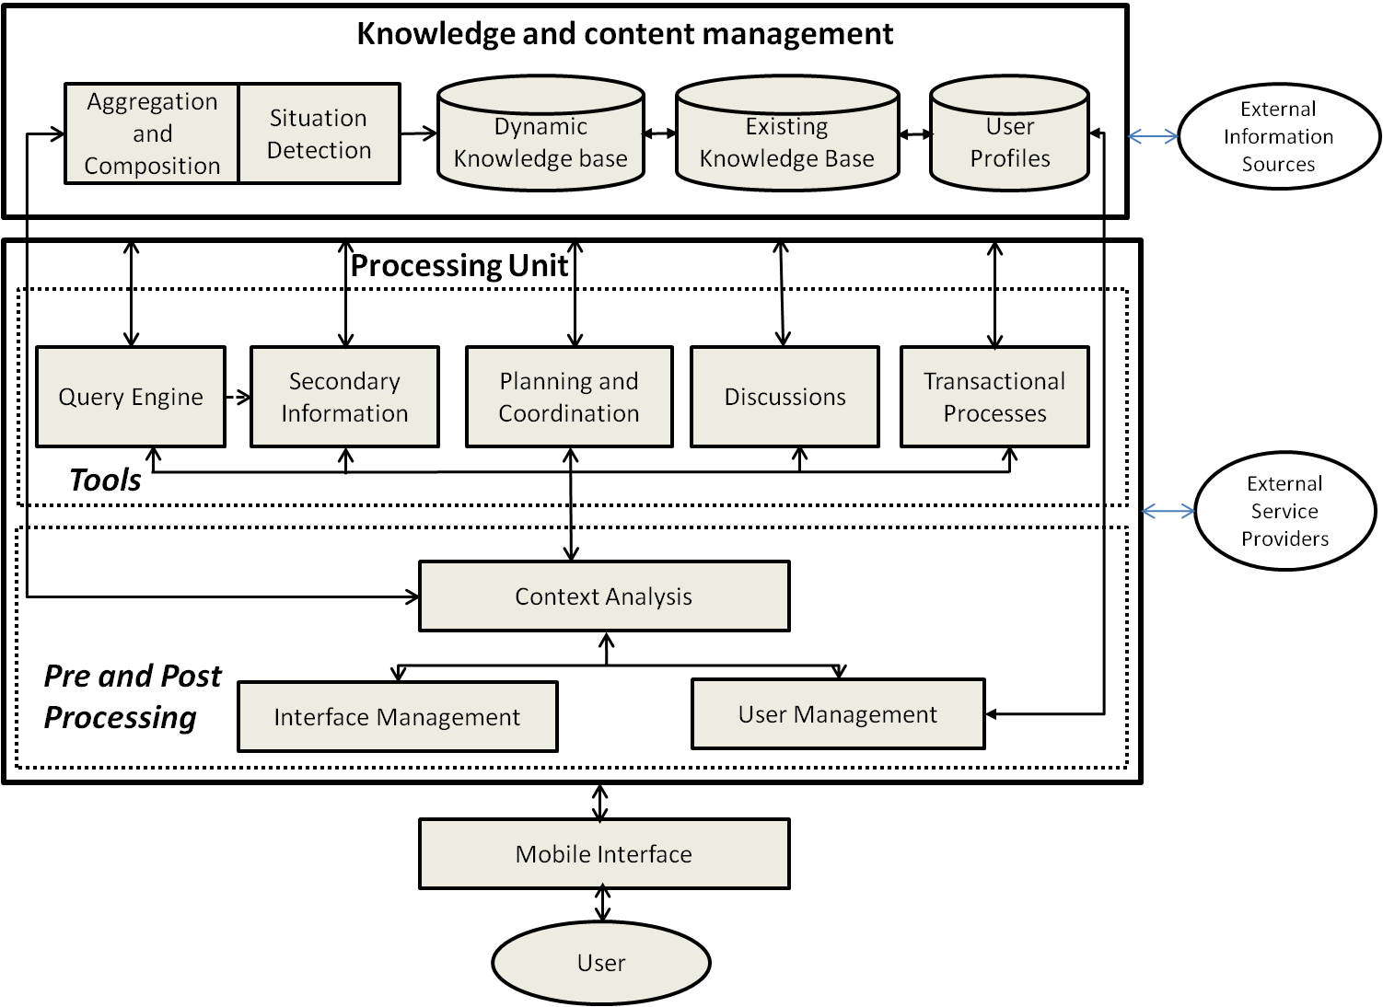
High Level Logical Architecture

